Slide 1

University Management Application
OOPS Group Project

Slide 2
Object Oriented Programing Project
Semester V
Submitted to Dr. Mukesh Kumar Giluka
Submitted By:
Avadhesh Kumar 20/11/EC/007
Chirag Beniwal 20/11/EC/008
Neeraj Nikhil Roy 20/11/EC/053
Kshama Meena 20/11/EC/055

Slide 3
Contents
Introduction
Product Information
Technologies Used
Walkthrough of Application(Brief)
Output

Slide 4
University management system
A Database-based university management system (UMS) is a digital solution that helps automate tasks. Ranging from registering students, admitting students, onboarding them, managing their fees, managing payroll for lecturers to helping students access online learning, classroom training etc.
A UMS is an education product that helps teachers, students, parents, external vendors, learning suppliers etc. come together via a platform and exchange information. The university administration can automate several of their processes such as attendance, announcements, results, campus updates, schedule changes etc. to all concerned persons. There is no limit on the number of features of the university management system, because every university will have its own set of processes that is different from another university. Therefore, a UMS should be able to help universities apply university-specific customizations as well as configure generalized workflows.

Slide 5
Why choose us? How is our product better than others?
There are three primary reasons why educational establishments should build university data management software.
Efficiency Manual entries, filling up papers, distributing pamphlets, putting announcements on physical bulletin boards are all inefficient. When all aspects of a university student administration process are online and automated, students have better leverage, control, and clarity. It saves time, cost, and confusion. Even teachers find that managing their activities, tasks, and scheduling is easier with a UMS. Teachers, faculty, and university administration personnel can focus on more creative tasks instead of wasting time on mundane repetitive tasks.

Slide 6
Flexibility
A UMS provides the flexibility to define workflows as per changing university requirements. Hard-wired software-based workflows prevent the university from applying case-based workflows. Instead, a flexible and highly-configurable workflow-system can support any number of use cases. It also lets the university expand its capabilities and offerings without worrying about a technological upgrade or overhaul.
Relevancy
A UMS is a bare necessity because education is becoming digital and online. Traditional classroom-based education is being replaced by virtual classrooms. The latter provides the same level of experience as the former. Added to that, virtual classrooms are a more powerful tool that enables a university to impart education to a wider and broader student base using the university ERP.

Slide 7
Eliminates data corruption either through willful misappropriation or by manual errors.
Data/information security with strong encryption.
Ability for customizations and extensibilities
Who needs a university management system?
Every university needs a university management system to stay competitive, in the reckoning, to win favor with students, and impart quality education. Without a UMS, a university will operate inefficiently, and will be unable to create any value for the student community and teachers.

Slide 8
Technologies used
This is a C++ project so obviously C++ language is used to make this application.
Concepts of Oops like getters, setters, constructor, destructors, encapsulation;
Concepts of DSA like Arrays and sorting methods are also used.
It is a graphic user interface project, so a lot of hours and time were spent on tutorials, books stack and git. Being a GUI project, a lot of work went into that too.
This project is created by us in windows environment, targeting windows application as of now later expanding horizons to others OS platforms like android, Linux and iOS.
It is created in Rad Studio, Visual Studio, Visual Studio Code.
GUI tools and libraries like OpenGL, Cmake, etc.

Slide 9

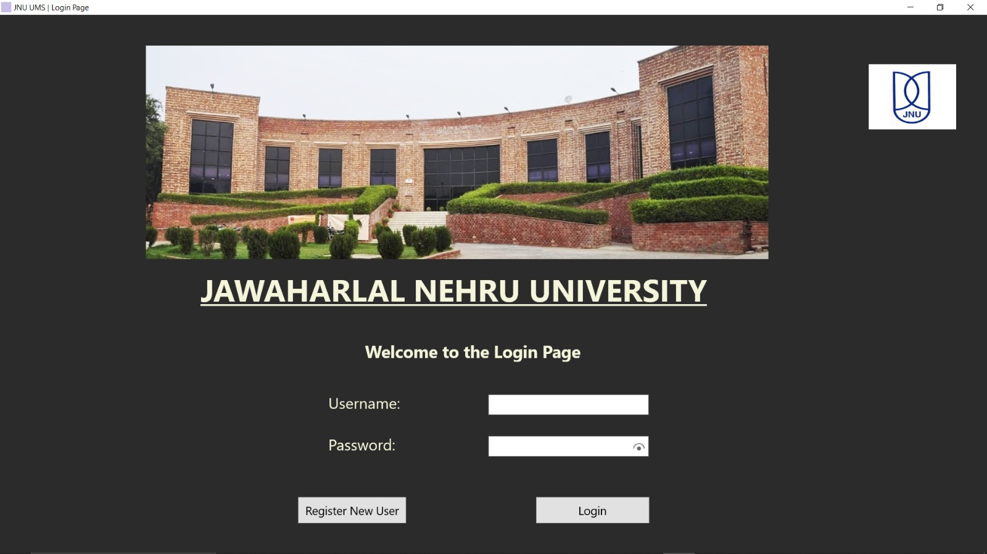
Login Page

Slide 10
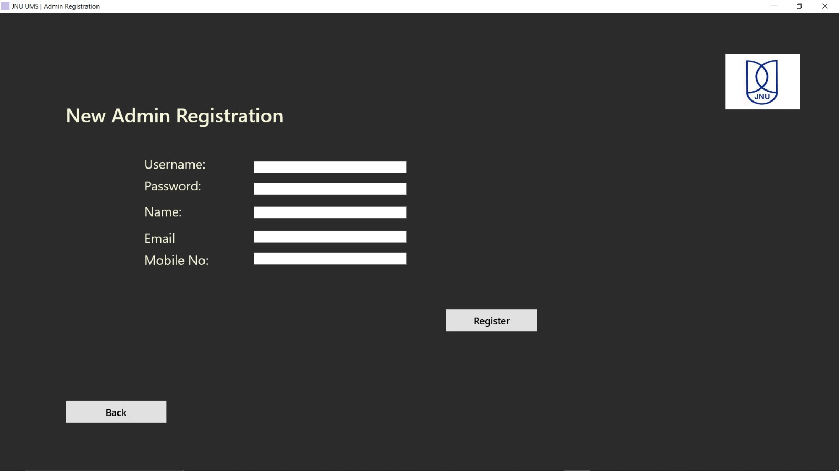
Admin Registration Page

Slide 11
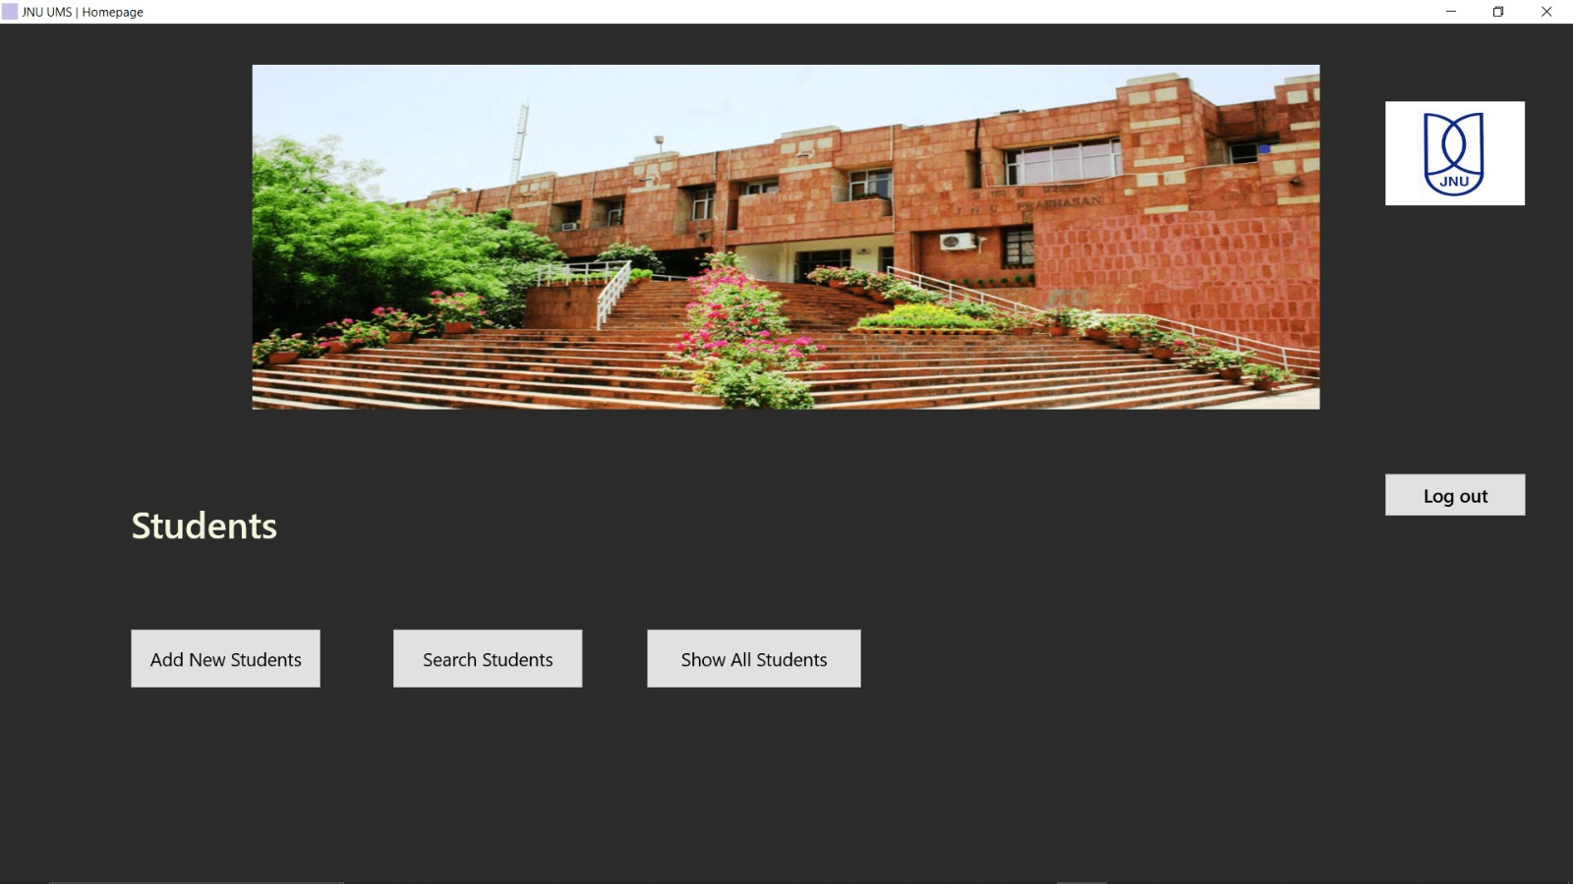
Home Page

Slide 12
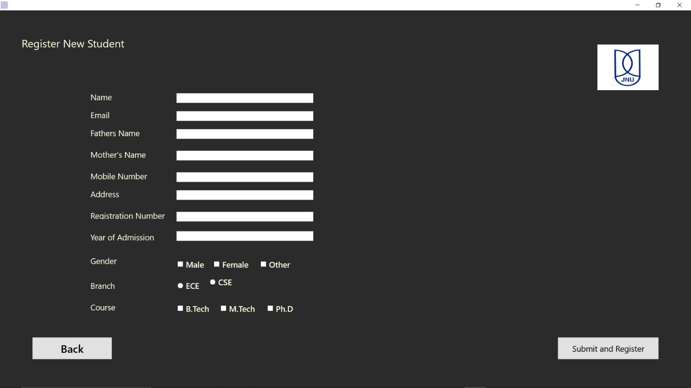
New Student Registration page

Slide 13
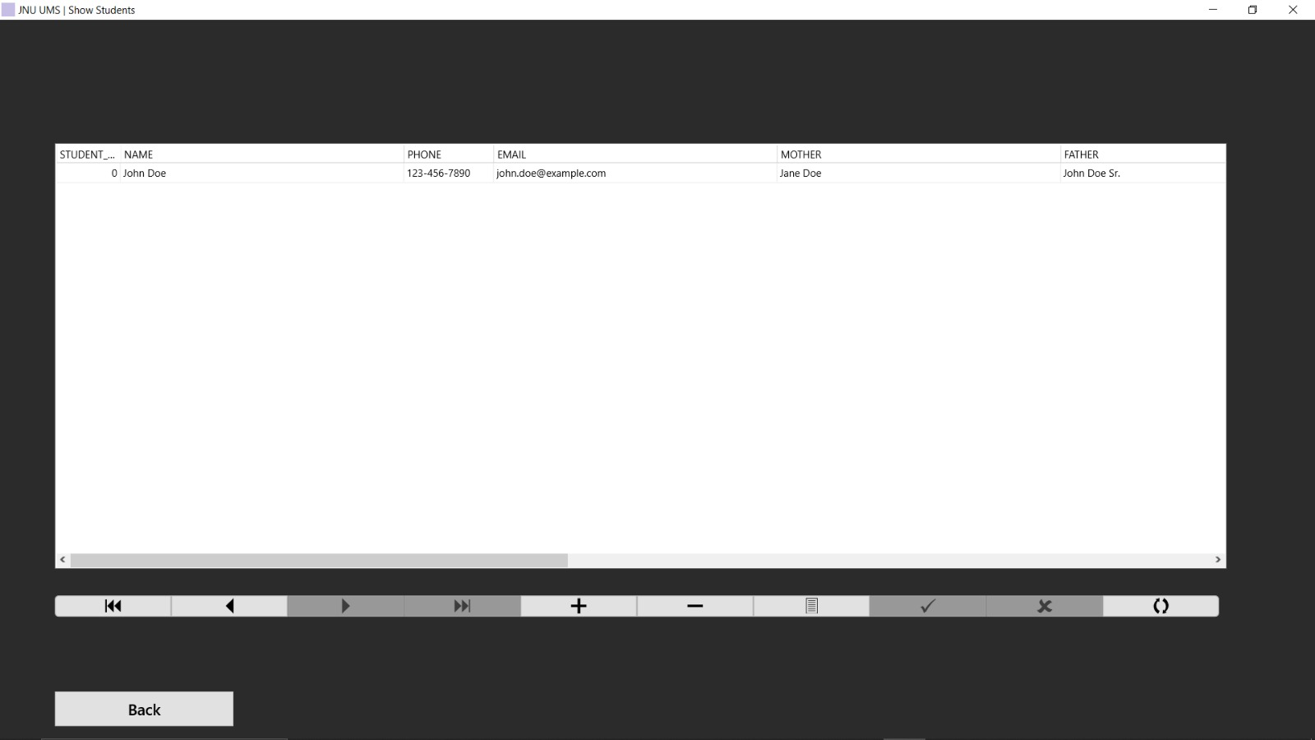
Show all student page

Slide 14
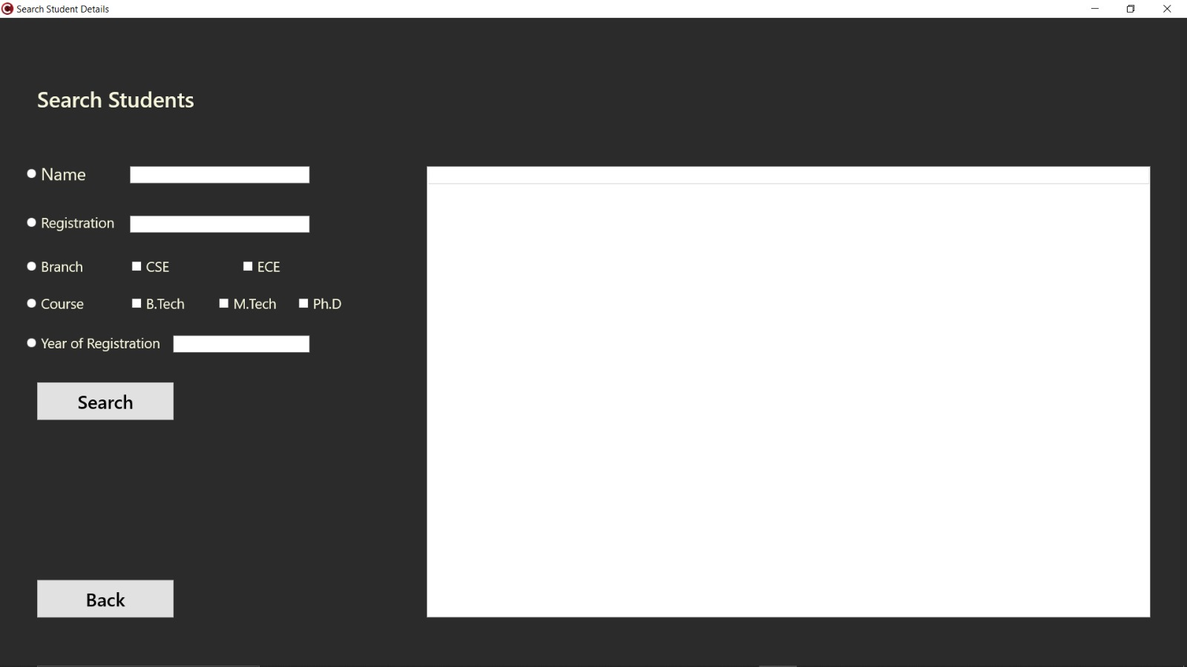
Search student page

Slide 15
THE END THANK YOU

